Slide 1
CUAE:
Deep-Dive through Demos
Seth Call

Slide 2
Session Objectives
At the end of this session, the participant should be able to:
Understand at a lower-level what the CUAE can do.
Feel comfortable sizing applications.

Slide 3

Application Design Walkthrough
Cisco Directory Click-to-Talk
Retail Mock-up
Salesforce Integration with CallManager/CUAE

Slide 4
Cisco Directory Click-to-Talk
Click-to-Talk is a significantly horizontal application.
Typical Requirements:
  I want my employees to be efficiently connected to one another via interfaces which my employees use daily.
Case Study:
  Cisco employees use the internal web directory as the primary resource to look up contact information about other employees.
  However, this interface is not click-to-talk enabled.

Slide 5
Building a C2T Demo within Cisco
To add additional features to the Cisco directory, one can either convince IT to add the necessary plumbing, or build a client-side plugin which adds the new feature.
Say we were to build a plugin which added clickable phone icons next to every phone number in the directory.
If clicking the icon were to send an HTTP request to the Application Server, then an application could use that is a ‘trigger’ to initiate a script which will perform the desired behavior.

Slide 6
Walkthrough the Application
Step 1: User looks up a user in the directory, clicks phone number icon.
  Plugin sends HTTP request to the Application Server.
Step 2: Application determines phone of user and number of to-call party.
  The incoming HTTP request could send all this information.
Step 3: Application sends Dial command to the user’s phone.
  The application sends a ‘Cisco IP Phone Execute’ command (XML-over-HTTP) to the user’s phone, with a command to dial the to-call party.
Step 4: Application sends HTTP response back to the plugin.
  By holding the response of the HTTP request until the desired action is done, one can convey back to the plugin (and therefore the user) of how the C2T request went.

Slide 7
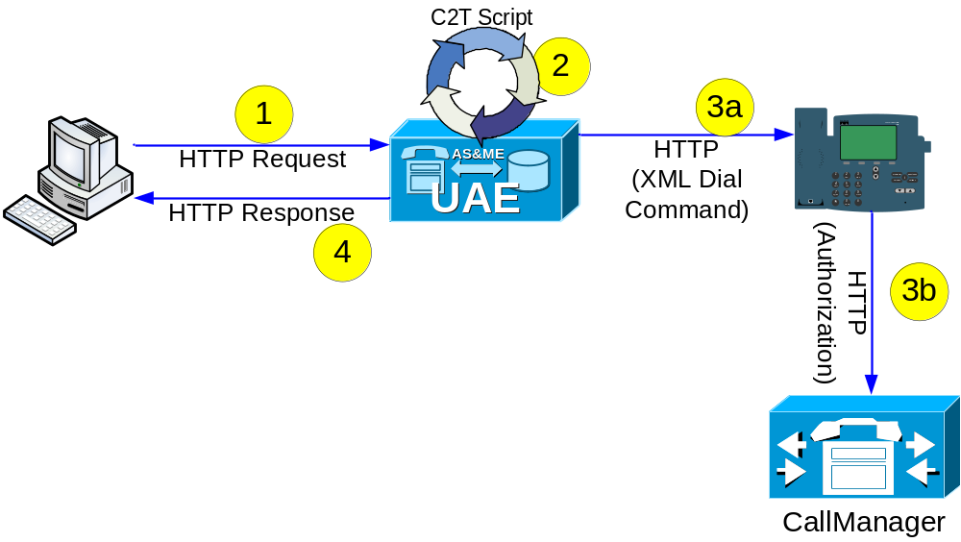
Walkthrough the Application

Slide 8
Exercise: From App Requirements to SKUs
Customer has 45000 users across globe. 30,000 are in US making it the heaviest region. 30,000 becomes the gate.
  10,000 EST
  7,500 CST
  2,500 MT
  10,00 PDT
Customer expects average user to utilize the C2T application 5 times a day in a 10 hour work window.
  8AM EST is US activity start time.
  As each timezone comes active, another set of users come on board.
  During 5 peak hours, all 30,000 users are active.
  30,000 * 5 (day) = Rate of 150,000 requests a day for peak US time.
  150,000 / 10 = 15,000 requests an hour at peak US time.
  Sizing metric of 20 HTTP requests a second = 72,000 BHCA.
  72k BHCA >> 15k BHCA.
  Scripts last for roughly 1 second.
Customer wants redundancy.
  Need a CSS for HTTP redundancy.

Slide 9
Exercise: From App Requirements to SKUs
Hardware & node licenses for co-located solution
  2 AP7845-K9-AS2.3-H1
  2 UAS2.3-S-25-50=
  0 UME2.3-H3.0=
Additional Script licenses
  Standard is sufficient due to 25 script licenses.
Media Engine licenses
  0 UME2.3-H3.0-MR-NEW
Text-to-speech licenses
  0 UME2.3-N3-TTS-NEW
Notes:
1 7845-H1 per node. Can run CUAS & CUME co-located.

Slide 10
Retail Mock-Up
The Retail Mock-up application serves to provide stimulus to the concept of CUAE development practices focusing on a vertical.
Typical Requirements:
  I want my retail employees ‘on the floor’ to have the ability to communicate immediately to other employees based on presence and their skill-set.

Slide 11
The Scenario
All employees ‘on the floor’ at a big retail company have 7920/7921.
All employees are associated with product SKUs in a database, based on expertise.
Employees have active and inactive periods (i.e., they do or don’t have a 7920/7921 in their possession and are on the clock)

Slide 12
Walkthrough The Application
Step 1: Employees use an IP Phone Service at 7970s located at any kiosk to log in.
Step 2: Employees presence information is updated.
  CUPS integration gives ability to update status of user in CUPS. Other applications can leverage this CUPS information as well, now.
Step 3: Customer needs help with a particular product. Employee or customer activates service. RTP channel is created.
Step 4: App user enters a product SKU with an IP Phone Service
Step 5: Application finds product SKU in database and also pulls out the product expert associated with that product, and returns information to 7970.
Step 6: Employee pushes Dial key which causes application to dial expert and connect both parties.

Slide 13
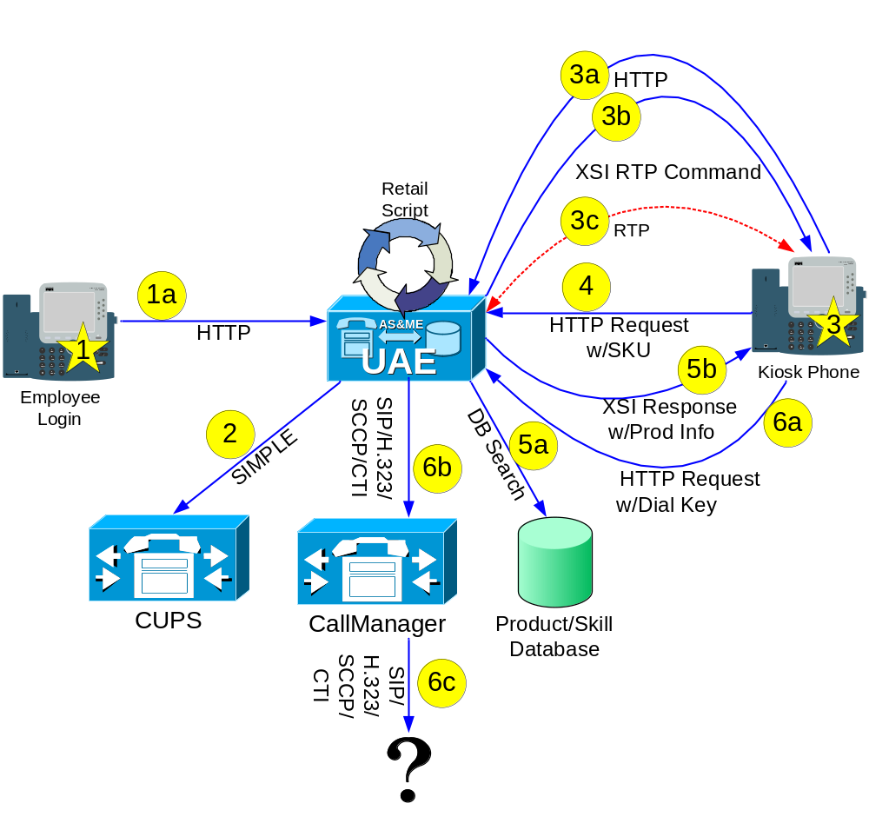
Walkthrough the App

Slide 14
Exercise: From App Requirements to SKUs
Customer has 1000 kiosks with the service installed in US.
Customer expects each kiosk to be used an average of 5 times an hour during holiday season.
Customer expects average session to last 4 minutes.
  1000 kiosks are only used 33% of the time (20 minutes / 1 hour)
  333 kiosks are in use at any one time if spaced evenly.
  Each application can use 2 RTP, 1 Voice = 666 RTP & 333 Voice needed.
  5K BHCA << 20K BHCA**
Customer does not want redundancy.
Customer can not have low-bite rate codec due to phone behavior.

Slide 15
Exercise: From App Requirements to SKUs
Hardware & node licenses.
  4 AP7845-K9-AS2.3-H1
  1 UAS2.3-P-100-UL=
  3 UME2.3-H3.0=
Additional Script licenses
  3 UAS2.3-INST-100=
Media Engine licenses
  3 UME2.3-H3.0-MR-NEW
  666 UME2.3-H3.0-RTP-N
  333 UME2.3-H3.0-VOI-N
Text-to-speech licenses
  3 UME2.3-N3-TTS-NEW
  15 UME2.3-N3-TTS-N
Notes:
1 7845-H1 per node. Can run CUAS & CUME co-located.

Slide 16
Salesforce Integration
Salesforce is not an application used solely by call centers by any means, but most applications built for SF are geared towards the call center.
What if the CUAE could bridge Salesforce and CCM together for richer and seamless functionality, while creating an infrastructure for future applications.

Slide 17
Cisco & Salesforce Provide Free Code
Cisco & Salesforce have teamed up and created prototypes that bridge CME/IPCC, and offer the prototype code for free.
Riding on top of that effort, a prototype is in mid-way development for the CCM/CUAE. The code will be offered for free as a substantial kickstart for other CUAE development practice to add their own value.

Slide 18
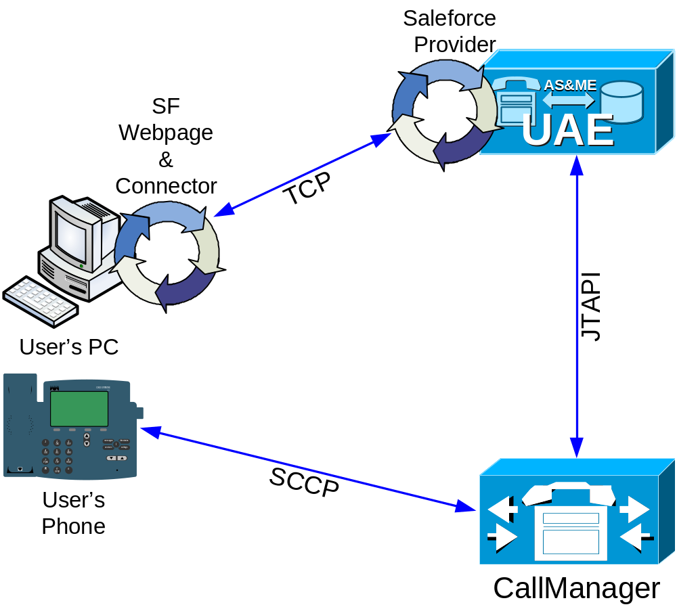
Application Architecture

Slide 19
Session Objectives Summary
In this session, you:
Understood at lower level what the CUAE can do.
Spent more soak-time with 3 applications to increase comfort level with the CUAE.

Slide 20

Q and A

